Slide 1
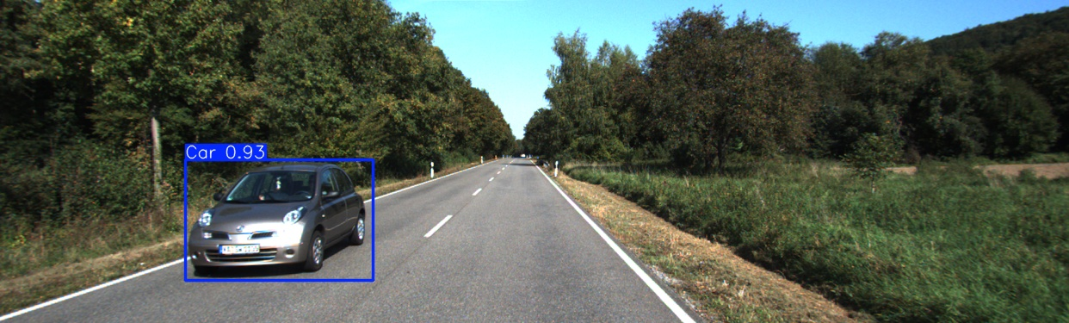
Evaluating Publicly Available Datasets for Object Detection in
ADAS with Cross-Country Comparison
AVE - Scientific Seminar

Slide 2
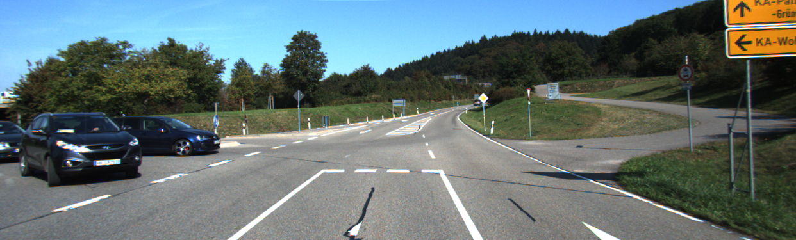
Overview of the seminar : Object Detection
Figure 1. A object detection dataset image. (Geiger et al., 2011)
Pg 1 Scientific Seminar

Slide 3
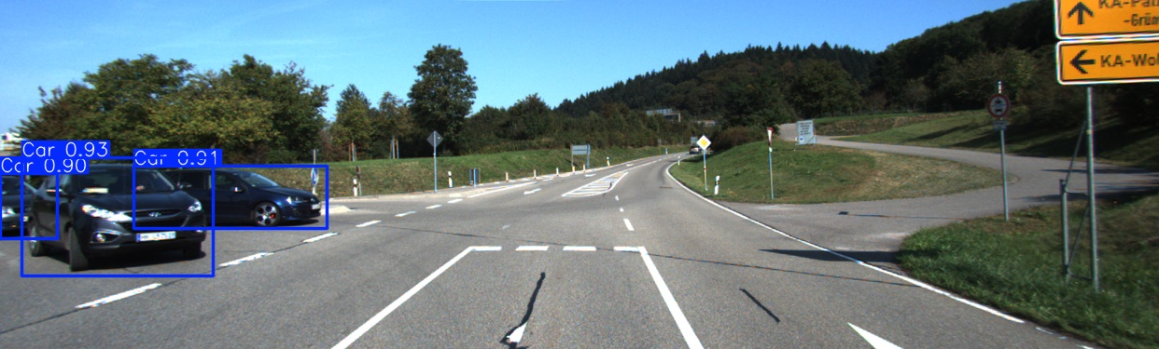
Overview of the seminar : Object Detection
Figure 2. A object detection dataset image. (Geiger et al., 2011) with bounding box
Pg 2 Scientific Seminar

Slide 4
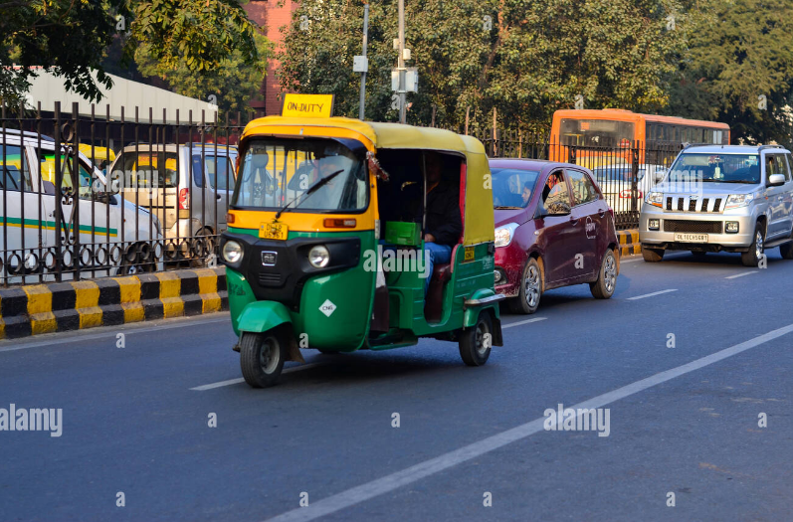
Overview of the seminar : Object Detection
Figure. 3 _______ Vehicle in Delhi (Arnold, 2016)
Pg 3 Scientific Seminar

Slide 5
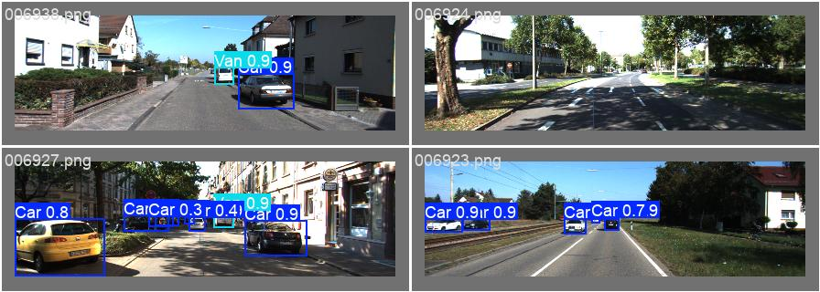
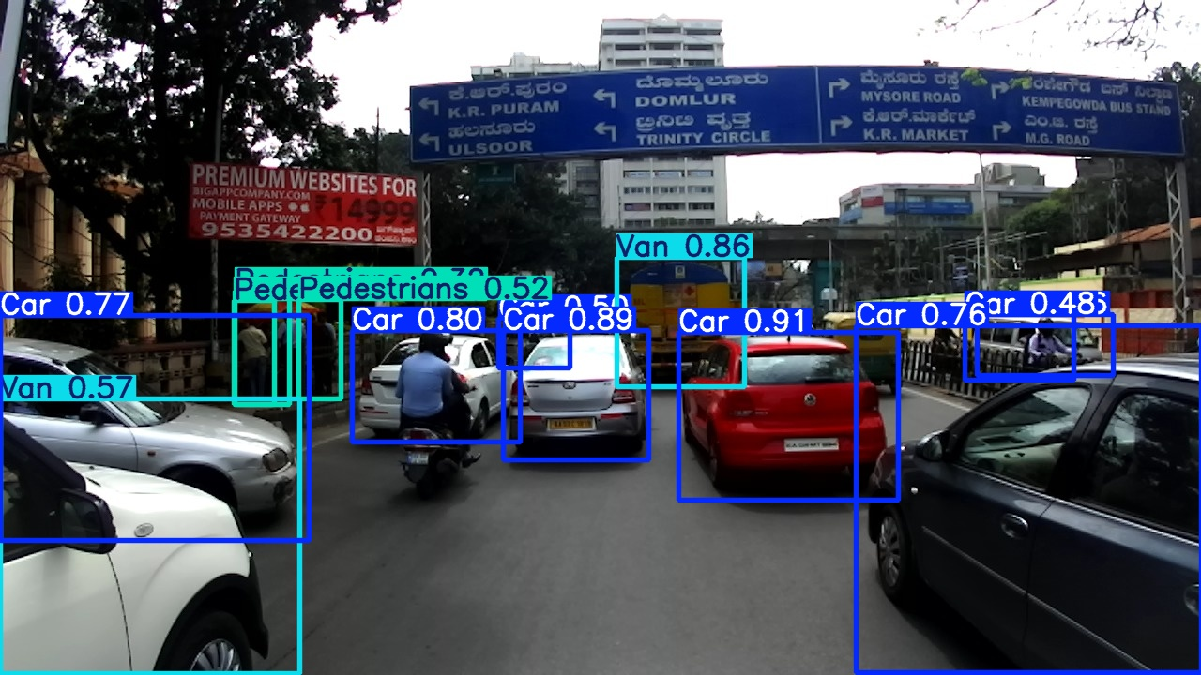
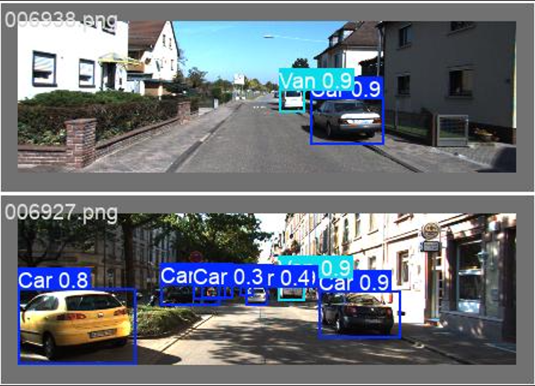
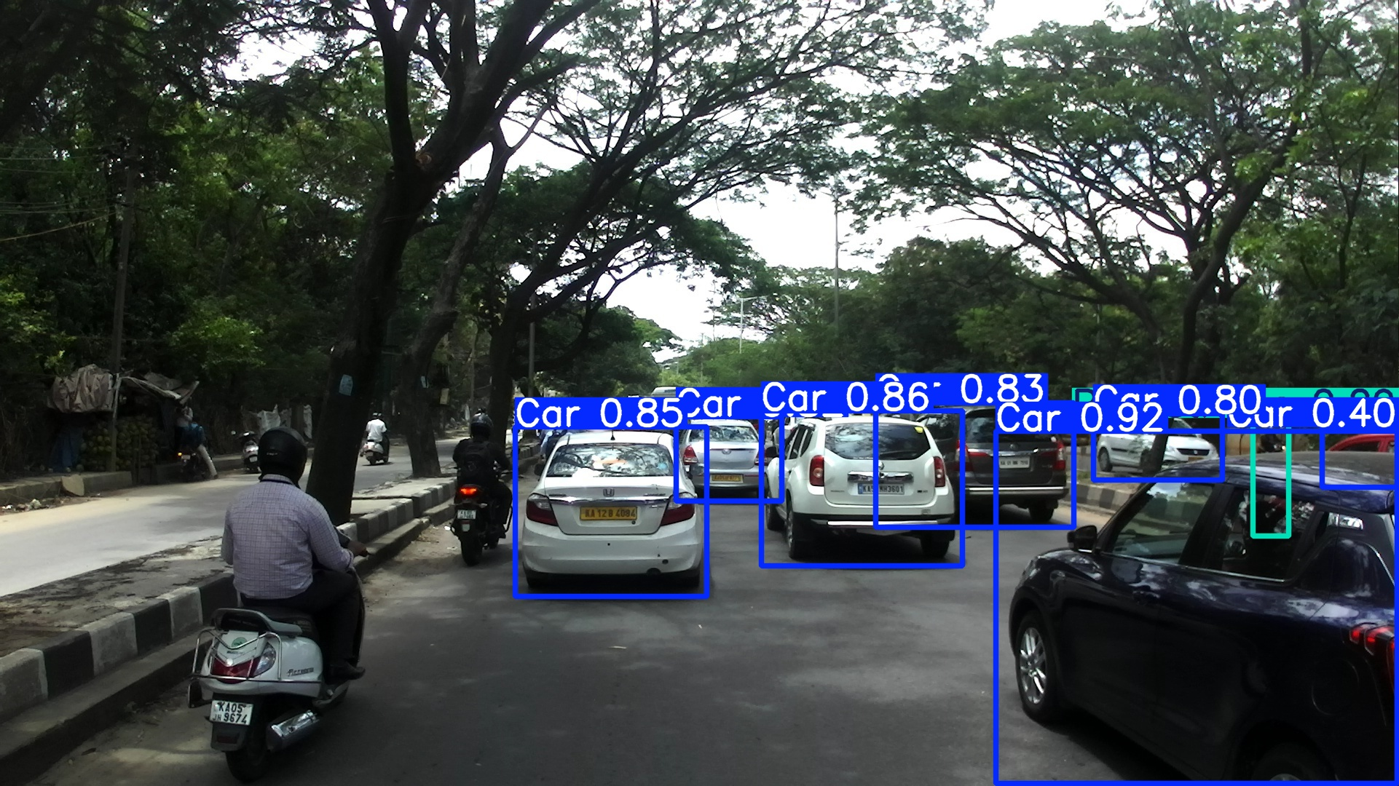
Same model, two worlds.
Figure 4 . A object detection dataset image. (Geiger et al., 2011) with bounding box
Figure 5. A object detection dataset image. (Kumar et al., 2018). With bounding box
Pg 4 Scientific Seminar

Slide 6
Introduction : Context & Motivation
Autonomous vehicles are transforming transportation.
ADAS (Advanced Driver Assistance Systems) play a key role in safer driving.
Real-time object detection helps recognize:
Vehicles
Traffic signals
Obstacles
Pedestrians
object detection models:
Are trained in controlled environments
Are often region-specific
Key Challenge: Cross-country generalization.
Different countries = different traffic, roads, and environmental conditions
Pg 5 Scientific Seminar

Slide 7
Introduction : Research Objective
Goal: Evaluate how well object detection models generalize across countries.
Approach:
Train model on dataset from one country
Test it on dataset from another country
Aim: Improve ADAS adaptability in diverse real-world scenarios.
Pg 6 Scientific Seminar

Slide 8
2. Literature Review : Publically available ADAS Datasets
Purpose: Train Machine learning models to detect+classify objects in RGB images using bounding boxes.
Data Source: Images from vehicle-mounted cameras showing real-world driving scenes.
Bounding Box: Coordinates enclosing each object
Label File: Includes object type, position, dimensions and rotation
Example Dataset – KITTI:
Created by KIT & Toyota Technological Institute
Urban, residential, and highway scenes
Classes: Car, Pedestrian, Van, Truck, etc.
Image resolution: 1242x375, RGB PNG format
Pg 7 Scientific Seminar

Slide 9
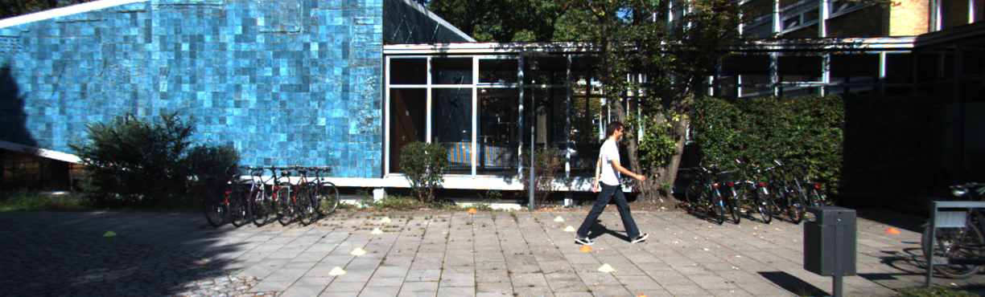
Image label bounding box
Figure 6. A object detection dataset image. (Geiger et al., 2011).
Pedestrian 0.00 0 -0.20 712.40 143.00 810.73 307.92 1.89 0.48 1.20 1.84 1.47 8.41 0.01
type truncation occlusion alpha bbox left bbox top bbox right bbox bottom height width length x y z rotation y
Pg 8 Scientific Seminar

Slide 10
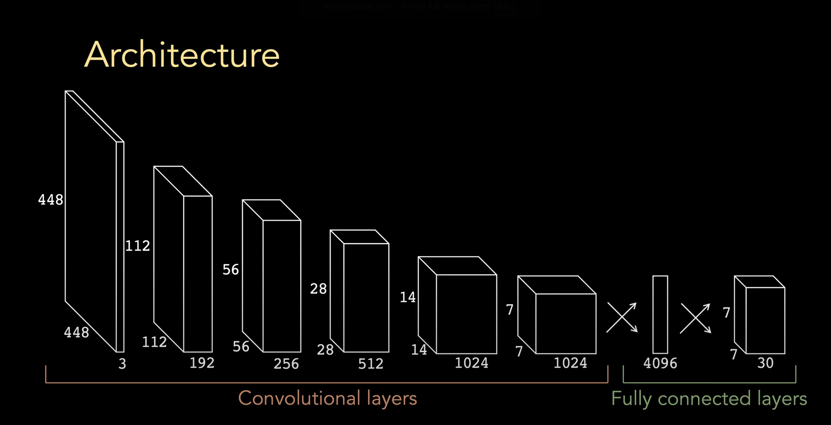
2. Literature Review : YOLO – Object Detection
YOLO = "You Only Look Once"
Treats object detection as a single, unified problem
CNN: Simultaneously detects and classifies all objects
Extremely fast – ideal for real-time systems like ADAS
CNN converts RGB image into hierarchical features
Early layers detect simple patterns (edges, colors)
Deeper layers detect complex shapes (wheels, pedestrians)
Figure 7. Convolutional neural networks . (Deepbean., 2023).
Pg 9 Scientific Seminar

Slide 11
2. Literature Review : YOLO – Object Detection
CNN output divided into grid cells
Each cell predicts bounding boxes + class probabilities
Softmax function used to convert raw scores into probabilities
Training uses two losses:
Cross-Entropy Loss: Encourages correct classification
Localization Loss (e.g., IoU): Improves bounding box accuracy
Training enables joint learning of classification + localization
Balance of speed & accuracy is ideal for multiclass detection and classification in ADAS
Pg 10 Scientific Seminar

Slide 12
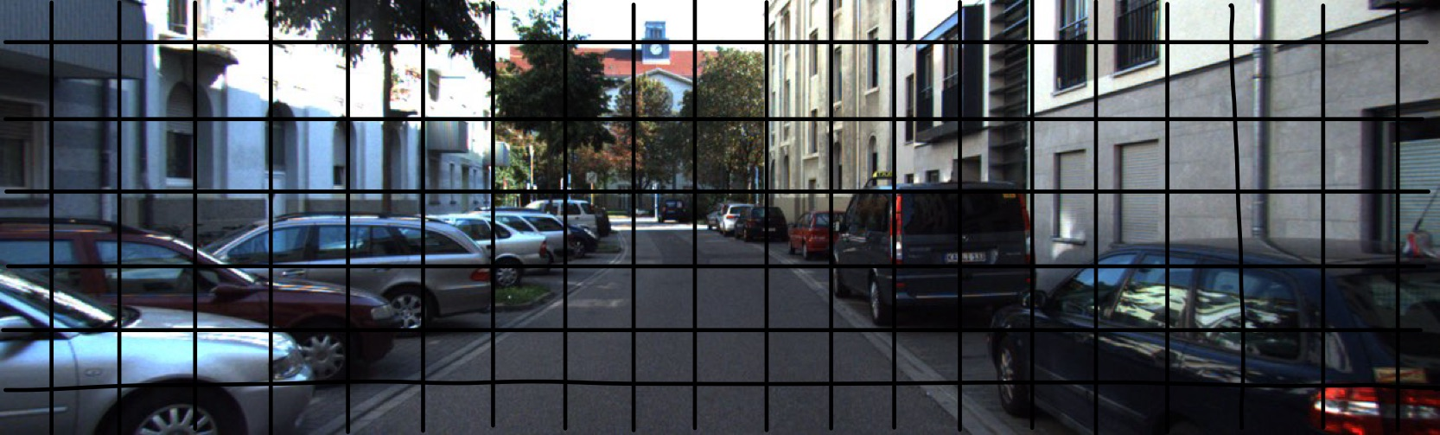
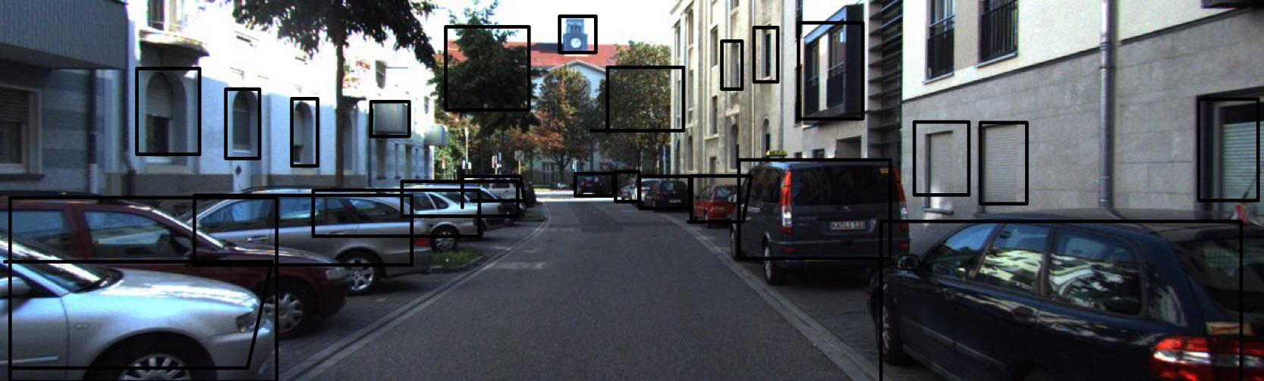
Figure 8 . A object detection dataset image. (Geiger et al., 2011).with grids
Pg 11 Scientific Seminar
Figure 9 . A object detection dataset image. (Geiger et al., 2011).with objectness

Slide 13
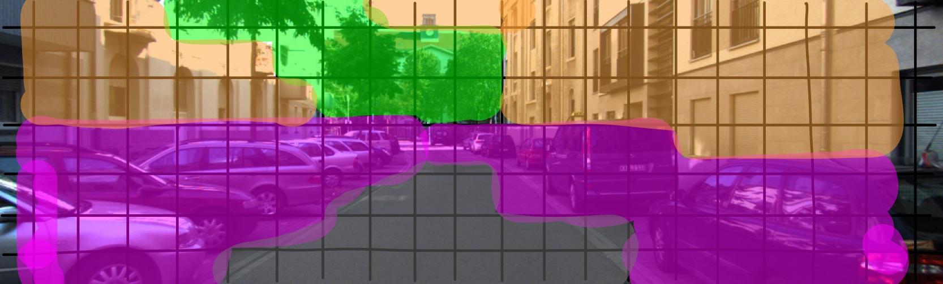
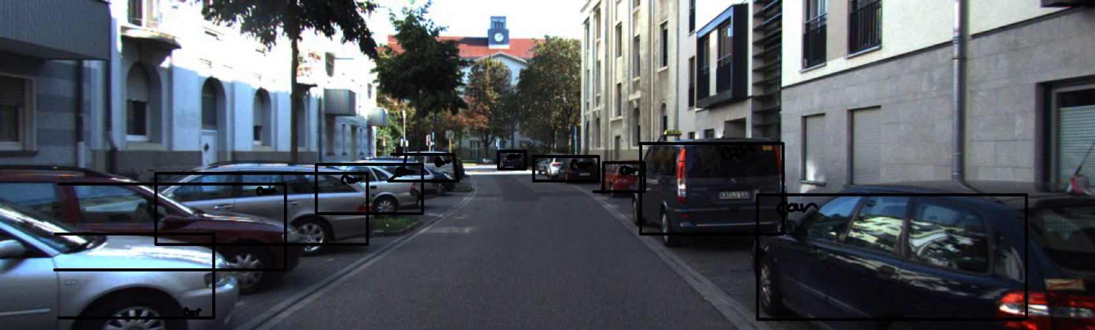
Figure 10 . A object detection dataset image. (Geiger et al., 2011).grids and objectness classification
Pg 12 Scientific Seminar
Figure 11 . A object detection dataset image. (Geiger et al., 2011).with bounding box

Slide 14
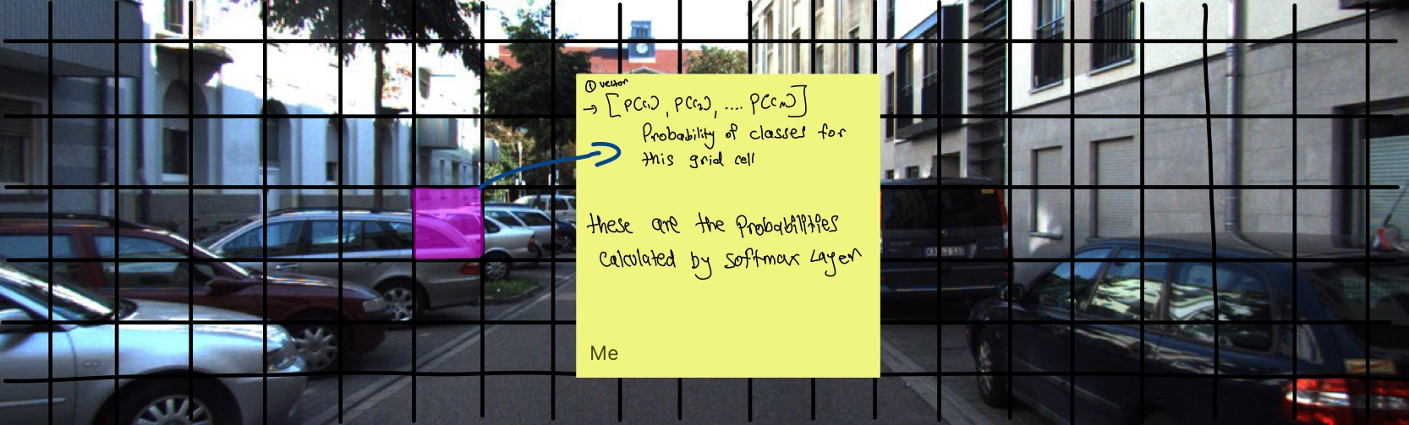
Figure 12 . A object detection dataset image. (Geiger et al., 2011).with grids and vector
Pg 13 Scientific Seminar

Slide 15
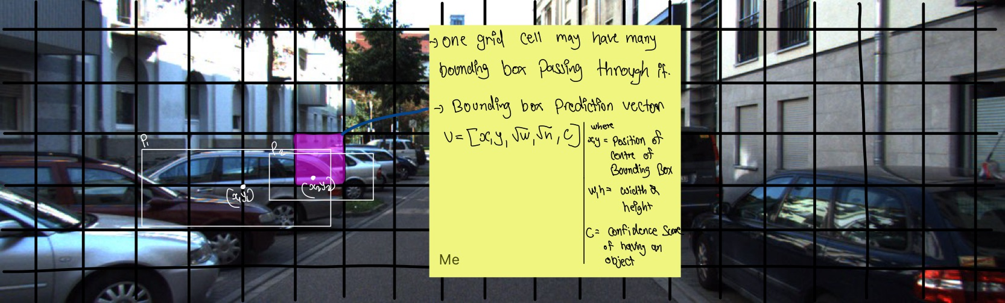
Figure 13 . A object detection dataset image. (Geiger et al., 2011).with bounding box class prediction vector
Pg 14 Scientific Seminar

Slide 16
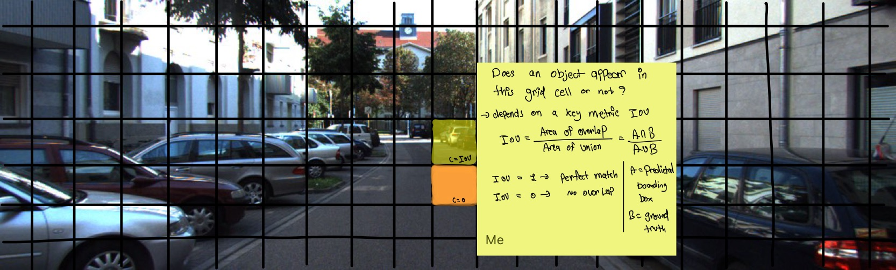
Figure 14 . A object detection dataset image. (Geiger et al., 2011).with IOU metric.
Pg 15 Scientific Seminar

Slide 17
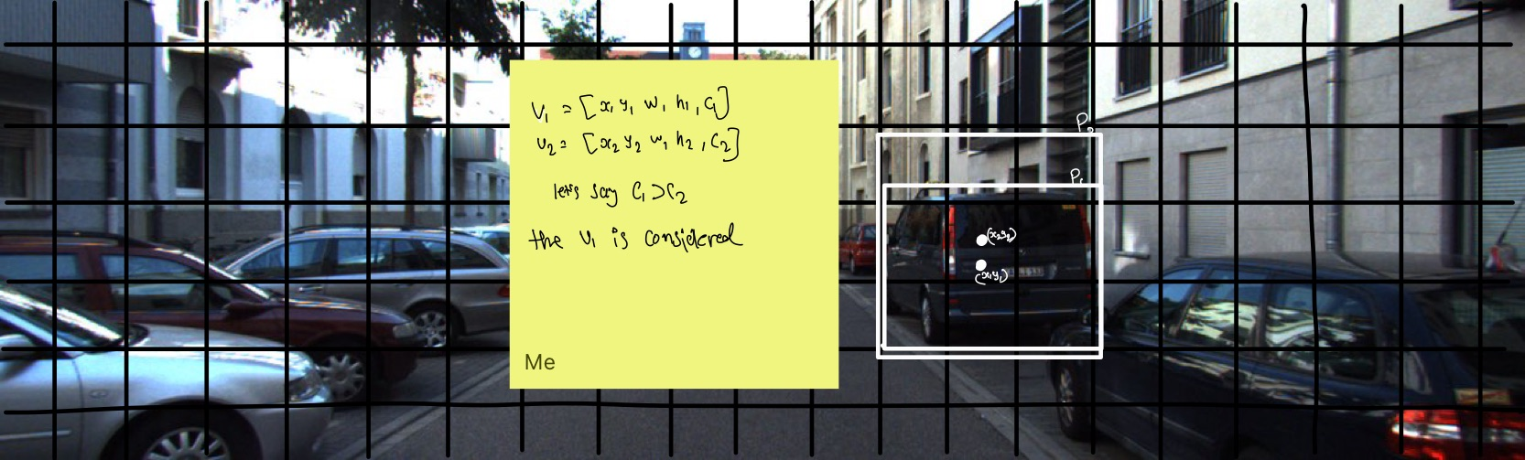
Figure 15 . A object detection dataset image. (Geiger et al., 2011).with bounding box vectors.
Pg 16 Scientific Seminar

Slide 18
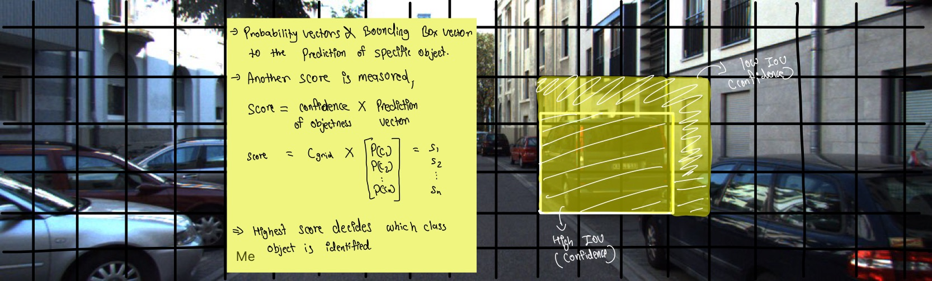
Figure 16 . A object detection dataset image. (Geiger et al., 2011).with objectness and class prediction.
Pg 17 Scientific Seminar

Slide 19
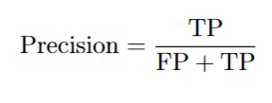
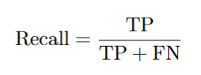
2. Literature review : Evaluation Metrics
Precision: How many predicted objects are correct
Recall: How many actual objects are correctly predicted
AP (Average Precision): Area under Precision–Recall curve (per class)
mAP@0.5: Mean AP at IoU = 0.5 (standard metric)
mAP@0.5:0.95: Mean AP across multiple IoU thresholds (strict evaluation)
Pg 18 Scientific Seminar

Slide 20
2. Literature review : Evaluation Metrics
YOLOv8 computes 3 main losses during training:
Box Loss (CIoU/GIoU) → Measures bounding box overlap accuracy
Class Loss (Cross-Entropy) → Penalizes incorrect object classification
DFL Loss (Distribution Focal Loss) → Improves bounding box localization precision
Pg 19 Scientific Seminar

Slide 21
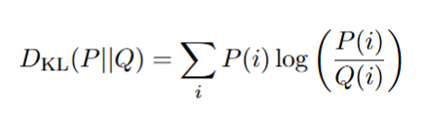
2. Literature review : Cross-Domain Generalization
Issue: Models trained on one dataset often fail on others
Cause: Visual differences across domains:
Lighting, object shapes, textures, camera angles, annotation style
Reason: Model learns domain-specific patterns not present in new data
KL Divergence:
Measures difference between feature distributions of training vs. testing datasets
High KL value → Large domain gap → Drop in detection accuracy (mAP)
Pg 20 Scientific Seminar

Slide 22
3. Tools and Technologies
Programming Language: Python 3.13
Pandas: Label handling (KITTI labels)
NumPy: Numerical operations on image data
Matplotlib: Training visualizations plots
OpenCV: Image preprocessing (resize, normalization)
Object Detection Framework:
YOLOv8 (Ultralytics): One-stage detector with CIoU loss
Used pre-trained COCO weights (yolov8l.pt)
Hardware & Environment:
Ubuntu Linux, Intel i9 CPU, NVIDIA Quadro RTX 4000 (8GB VRAM)
64 GB RAM, Visual Studio Code as IDE
Pg 21 Scientific Seminar

Slide 23
4. Methodology – Dataset Preparation for YOLO
Dataset Used: KITTI Object Detection
7,481 training images & 7,519 test images (JPEG format)
Labels include: class, 2D bounding box, occlusion, dimensions, etc.
Label Format Conversion:
Converted from KITTI format to YOLO format: <class_id> <x_center> <y_center> <width> <height>
Dataset Split
80/20 split → 5,984 training images, 1,497 validation images
Purpose: Prepare KITTI data for YOLOv8 model training
Pg 22 Scientific Seminar

Slide 24
4. Methodology – Model Training setup
Framework: Ultralytics YOLOv8 (Python API) Pretrained Model: yolov8l.pt (COCO weights) Image Input Size: 416 × 416 Device: GPU (NVIDIA RTX) Epochs: 100 Batch Size: 2
Data Configuration (data.yaml)
Dataset paths: train/images, val/images, train/labels, val/labels
Number of Classes: 5
Car, Van, Truck, Pedestrian, Person_sitting
Pg 23 Scientific Seminar

Slide 25
4. Methodology :Cross-Dataset Evaluation(German Model → Indian dataset)
Goal: Test KITTI-trained model on IDD (Indian Driving Dataset)
Class Alignment Process
KITTI: 5 classes → [Car, Van, Truck, Pedestrian, Person_sitting]
IDD: 15 classes → Unmatched classes removed
Class IDs reindexed to match KITTI (0–4)
Scripts Used
Filter and remap IDD labels
New data config YAML for IDD
Inference script using best.pt weights
Pg 24 Scientific Seminar

Slide 26
4. Methodology :Regional Adaptability Analysis
Evaluation Setup
In-domain: KITTI model on KITTI test images
Cross-domain: KITTI model on filtered IDD images
Compared Metrics
Precision
Recall
mAP@0.5
mAP@0.5:0.95
Adaptability Insight A significant drop in performance across metrics signals low generalization can be due to:Scene variation, Object diversity, Class distribution shift
Pg 25 Scientific Seminar

Slide 27
5. Results and Analysis : Performance on KITTI Dataset
Model: YOLOv8 (Trained for 100 Epochs) Dataset: KITTI Object Detection Validation Set Size: 1,497 images Final Evaluation Metrics (Epoch 100):
Precision: 0.941
Recall: 0.849
mAP@0.5: 0.9187
mAP@0.5:0.95: 0.7164
Pg 26 Scientific Seminar

Slide 28
5. Results and Analysis : Performance on KITTI Dataset
High Precision (94.1%) → Very few false positives
Strong Recall (84.9%) → Most objects detected
mAP@0.5 (91.9%) → Excellent detection accuracy at standard IoU
mAP@0.5:0.95 (71.6%) → Good performance across varying localization strictness
Pg 27 Scientific Seminar

Slide 29
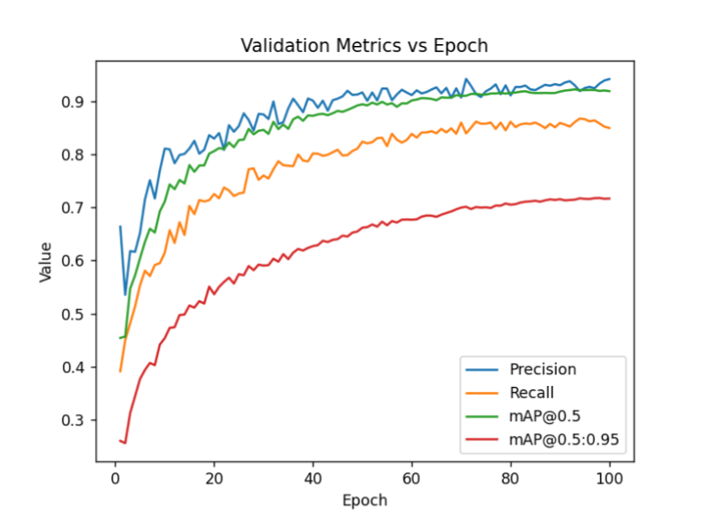
5. Results and Analysis : Performance on KITTI Dataset
Epoch-Wise Loss and Metric Trends
Figure 17 .Training logs : Validation metrics vs Epochs.
Pg 28 Scientific Seminar

Slide 30
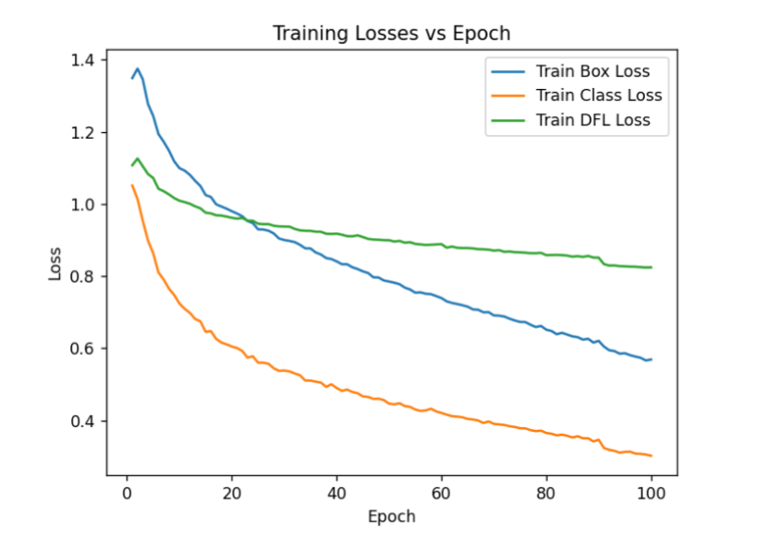
5. Results and Analysis : Performance on KITTI Dataset
Epoch-Wise Loss and Metric Trends
Figure 18 .Training logs : training losses vs Epochs.
Pg 29 Scientific Seminar

Slide 31
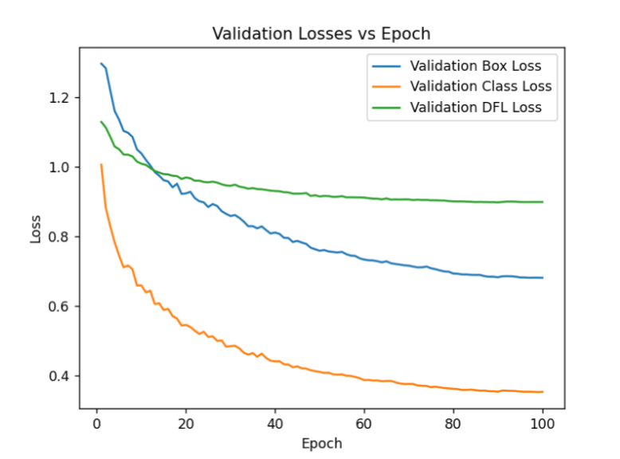
5. Results and Analysis : Performance on KITTI Dataset
Epoch-Wise Loss and Metric Trends
Figure 19 .Training logs : Validation metrics vs Epochs.
Pg 30 Scientific Seminar

Slide 32
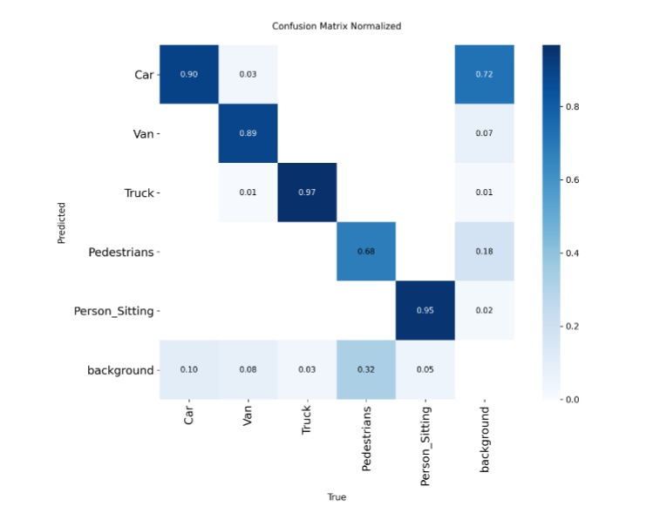
5. Results and Analysis : Performance on KITTI Dataset
Confusion Matrix and Class-Wise Observations
Figure 20 After training : Confusion Matrix normalized.
Pg 31 Scientific Seminar

Slide 33
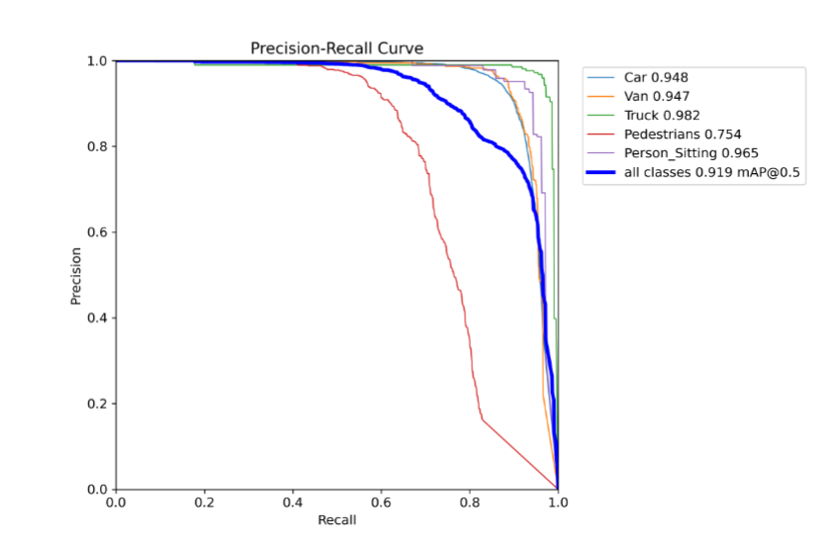
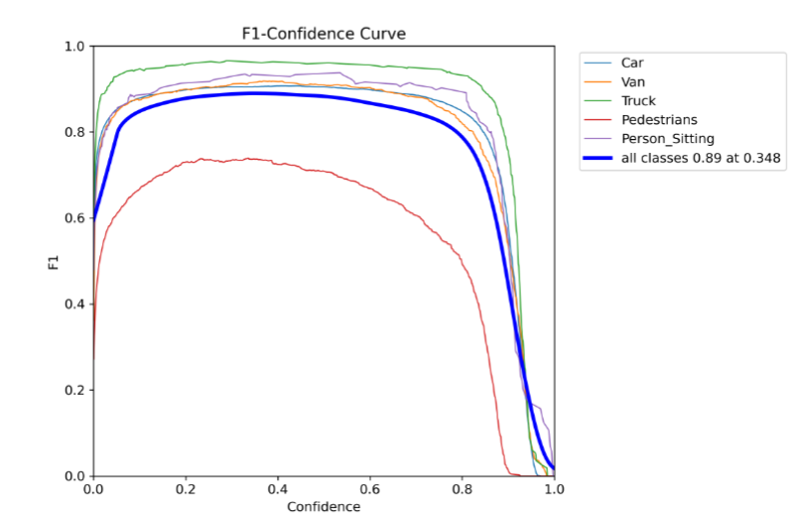
5. Results and Analysis : Performance on KITTI Dataset
Precision–Recall Curve and F1
Figure 21 After training : PR Curve.
Figure 22 After training : F1 curve.
Pg 32 Scientific Seminar

Slide 34
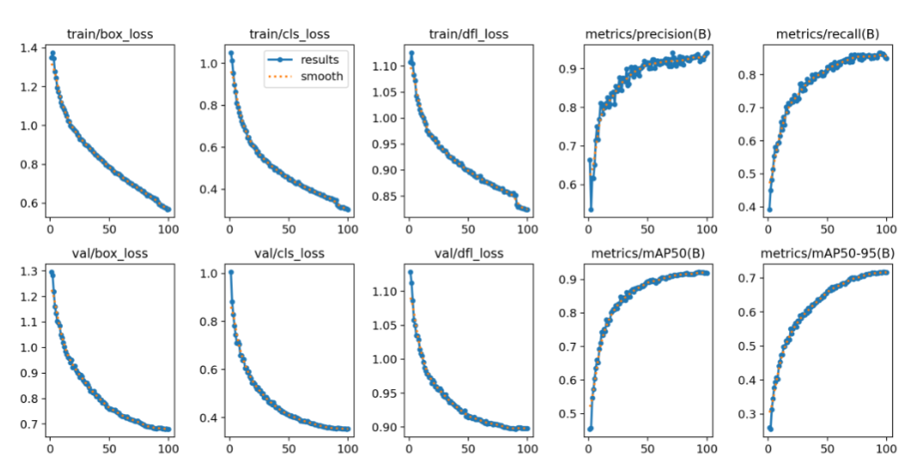
5. Results and Analysis : Performance on KITTI Dataset
Qualitative Results
Figure 23 After training : Qualitative results .
Pg 33 Scientific Seminar

Slide 35
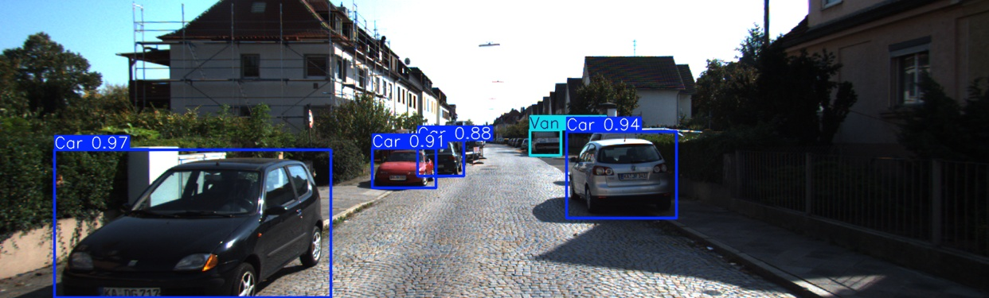
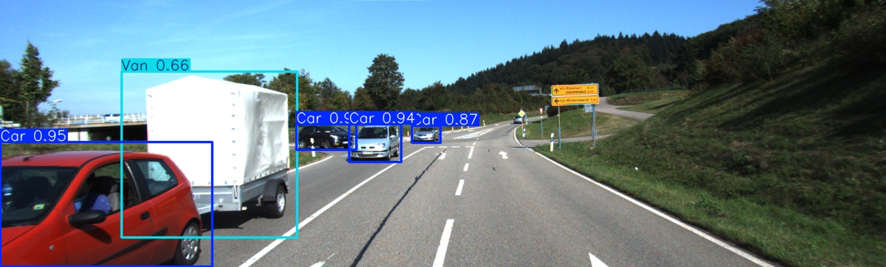
5. Results and Analysis : Performance on KITTI Dataset
Qualitative Results
After 100 epochs, model achieves high detection performance on the KITTI validation set—mAP@0.50
of 0.9187, with overall precision 0.941 and recall 0.849. Class confusion is minimal except for visually similar categories (Car and Van). These results establish a robust baseline for subsequent
cross-dataset evaluation.
Figure 24,25 . A object detection dataset image. (Geiger et al., 2011). With testing results
Pg 34 Scientific Seminar

Slide 36
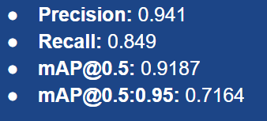
5. Results and Analysis : Cross-Country Analysis
5.2.1 Overall Metric Degradation:
Precision: 0.2509
Recall: 0.1229
mAP@0.50: 0.1217
mAP@0.50:0.95: 0.0649 Compared to KITTI mAP@0.50 of 0.9187, this drop shows major domain shift impact.
Possible Causes:
Drastic changes in scene complexity, object appearance, and traffic density
Poor generalization of features trained on European roads to Indian scenarios
German model to German roads
Pg 35 Scientific Seminar

Slide 37
5. Results and Analysis : Cross-Country Analysis
Class-wise mAP@0.50 score • "Van": 0.0227
• "Truck": 0.0005
• "Pedestrians": 0.0242
• "Person_Sitting": 0.0649
Only "Car" class showed moderate detectability
Other classes failed due to domain-invariant features being weak
Environment-induced occlusions, lighting, and diverse object types likely affected accuracy
Pg 36 Scientific Seminar

Slide 38
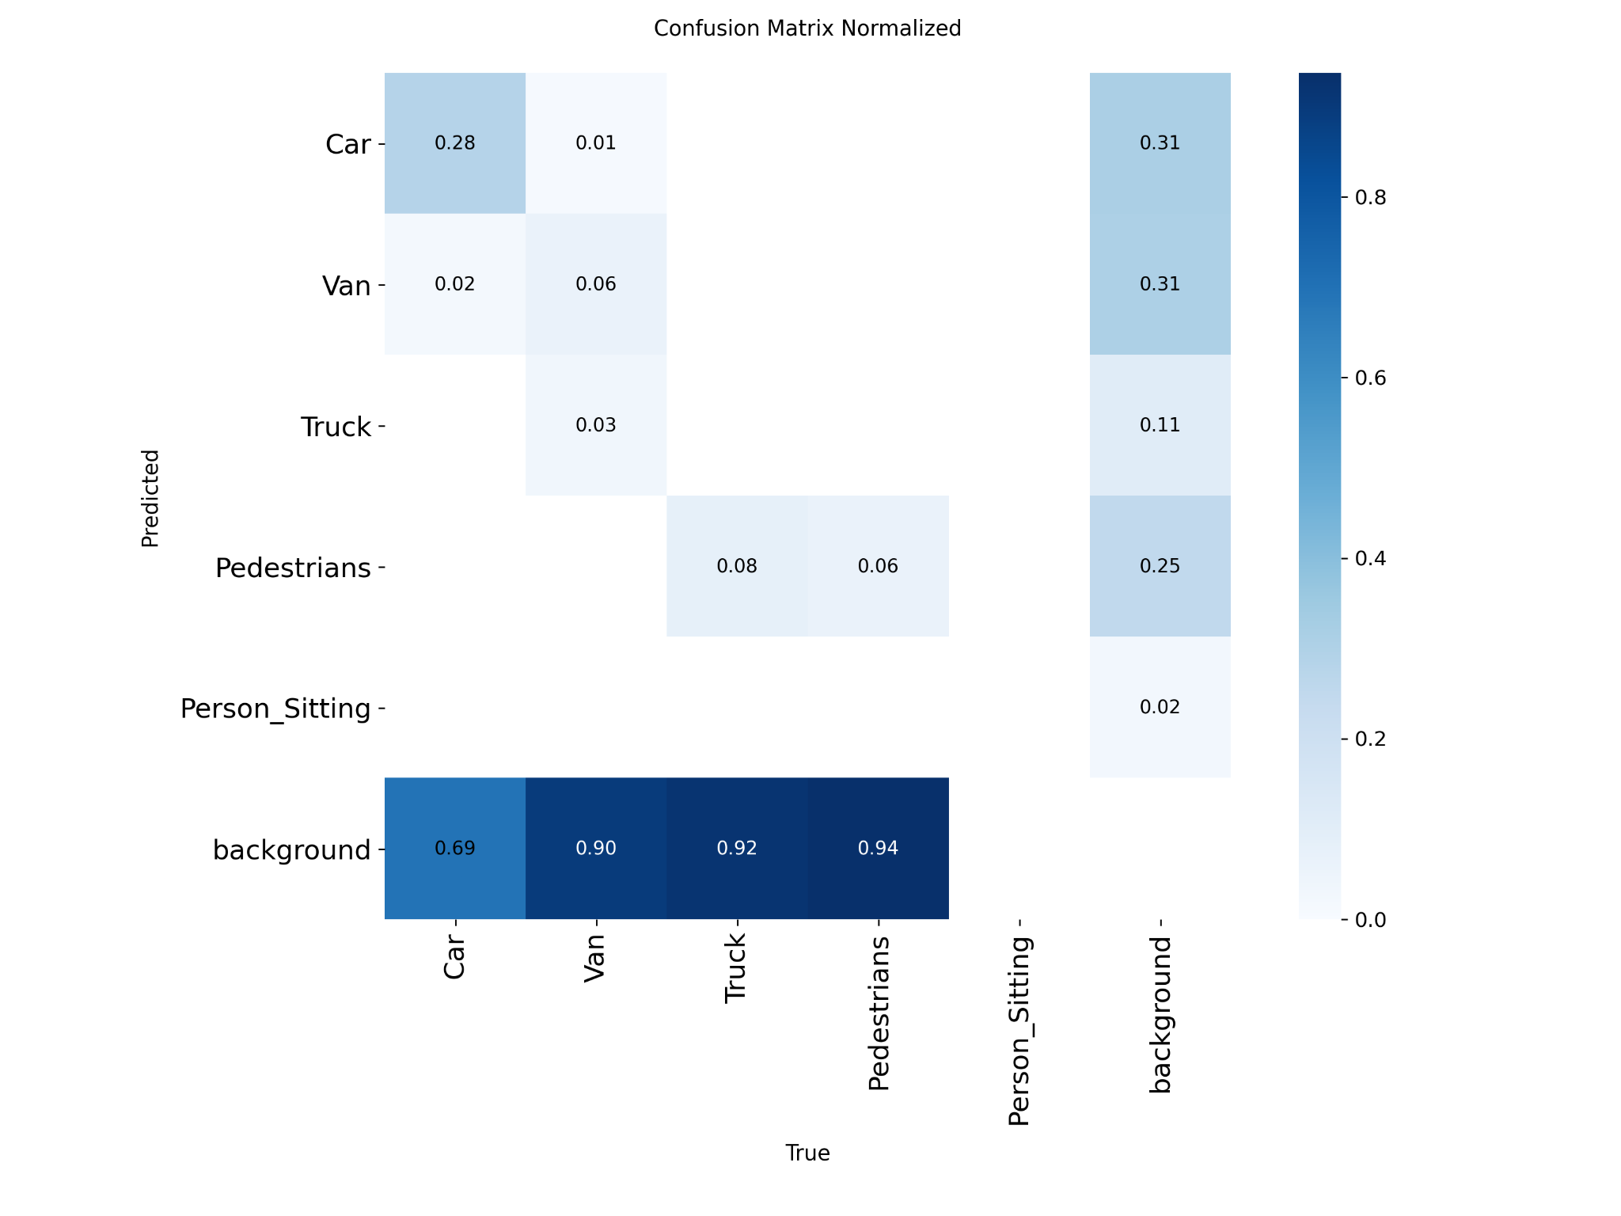
5. Results and Analysis : Confusion Matrix normalized
Confusion Matrix and Class-Wise Observations
The confusion matrix highlights frequent misclassification of real objects as background.
under-detection is observed for "Trucks" and "Pedestrians."
High background predictions shows the model struggles to recognize key objects in the Indian dataset.
This reflects poor generalization across domains.
Figure 26. Confusion Matrix Normalized
Pg 37 Scientific Seminar

Slide 39
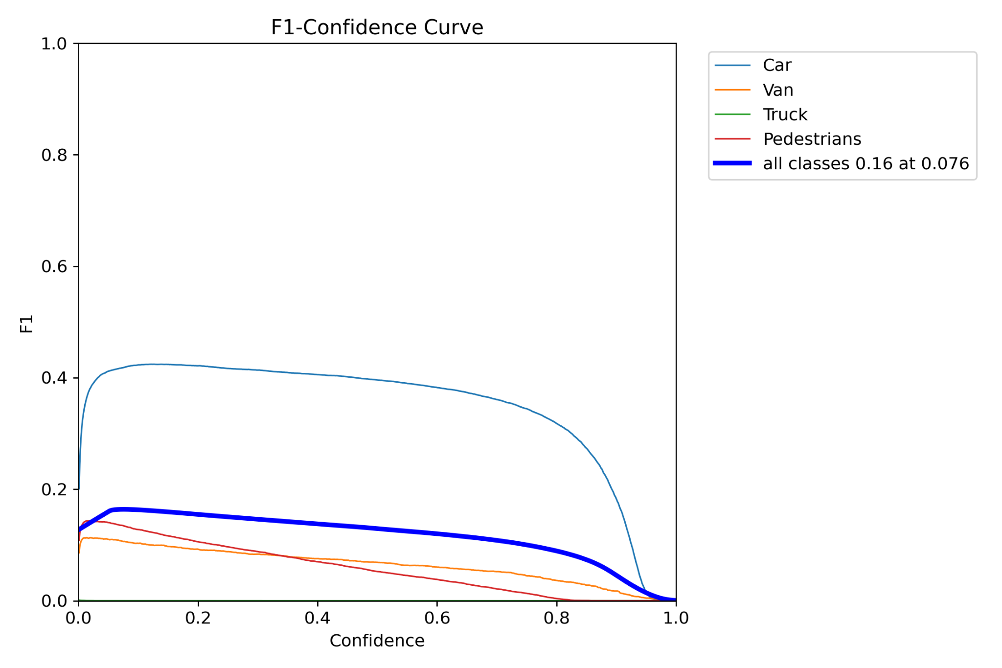
5. Results and Analysis : Confusion Matrix normalized
F1 Curve for Cross-Domain Evaluation
The F1-Confidence curve shows how precision and recall trade off across confidence levels. The overall F1-score peaks at a low value, confirming weak performance.
Most classes show low F1-scores, highlighting poor generalization in the Indian dataset.
Indicates the model is not reliable for cross-domain object detection.
Figure 27. F1 Curve
Pg 38 Scientific Seminar

Slide 40
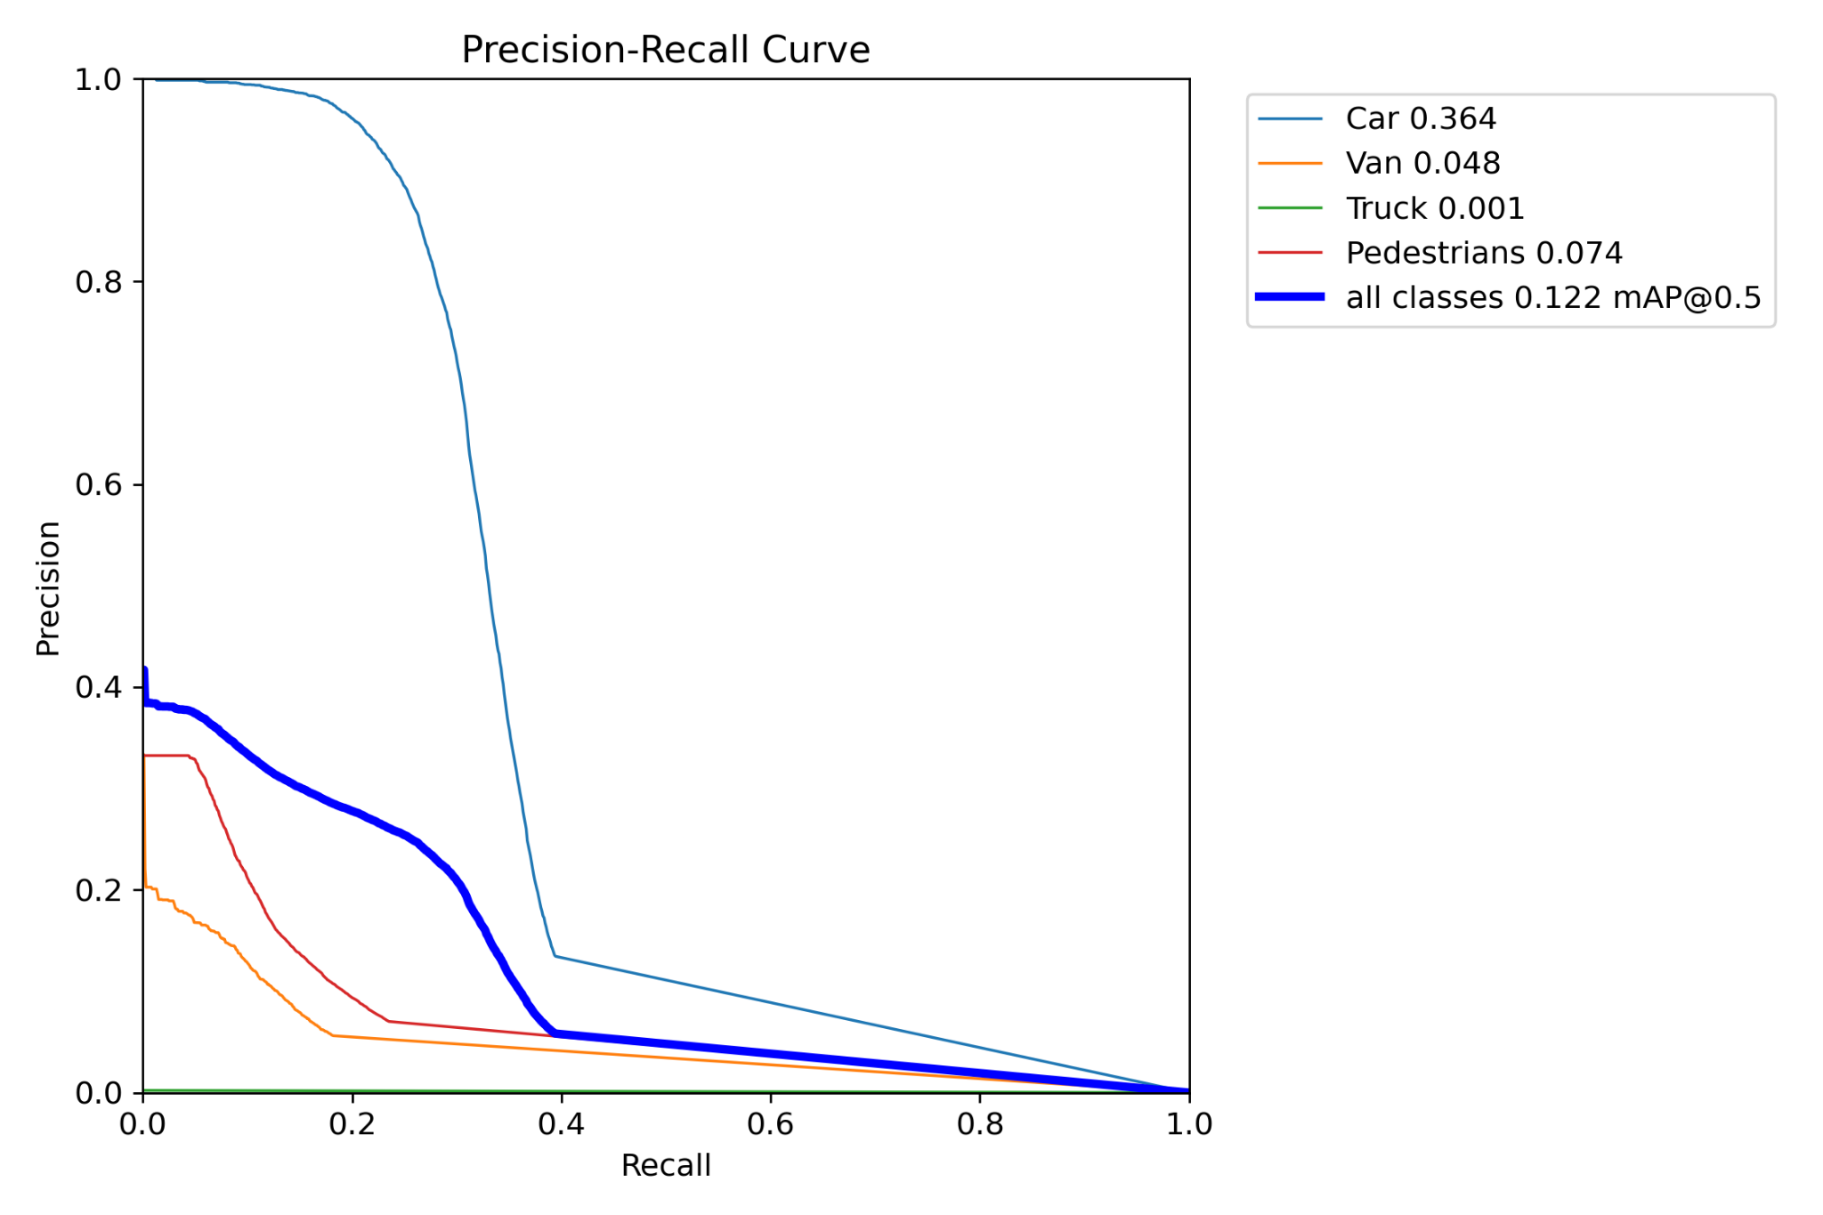
5. Results and Analysis : Confusion Matrix normalized
Precision-Recall (PR) Curve for Cross-Domain Evaluation
The Precision-Recall curve highlights a sharp drop in performance on the Indian dataset.
Precision stays below 0.3 even at low recall levels, and recall never exceeds 0.15.
Most high-confidence predictions are incorrect, indicating many false positives. The model retrieves only a small portion of true objects, with just 12.3% overall recall.
Low overall precision (25.1%) further confirms the high rate of misclassification.
Figure 28. PR curve
Pg 39 Scientific Seminar

Slide 41
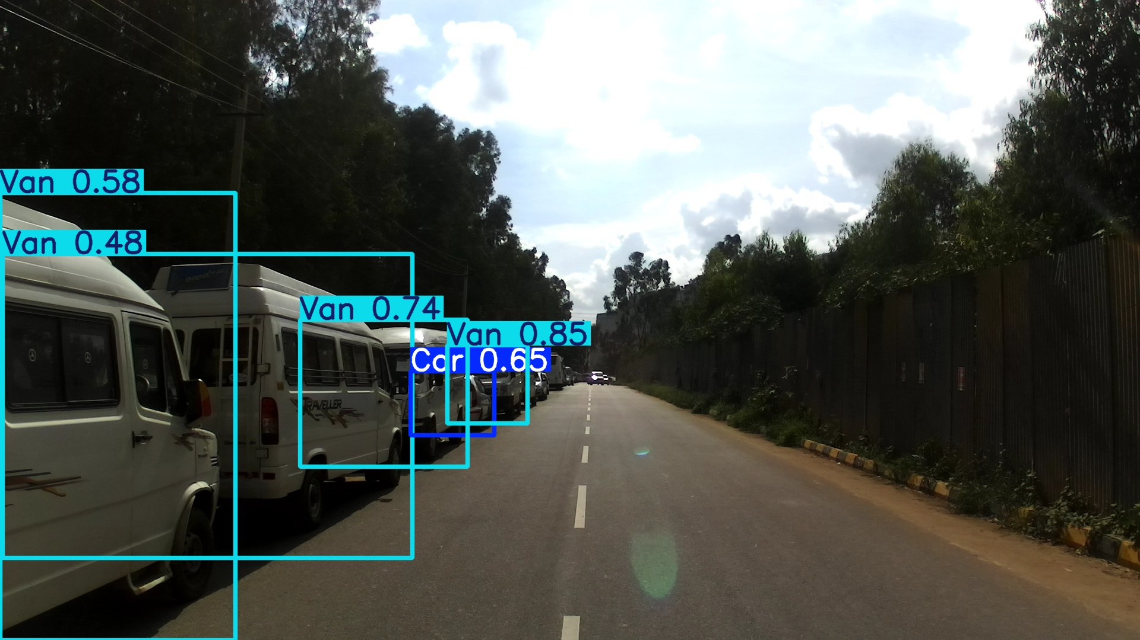
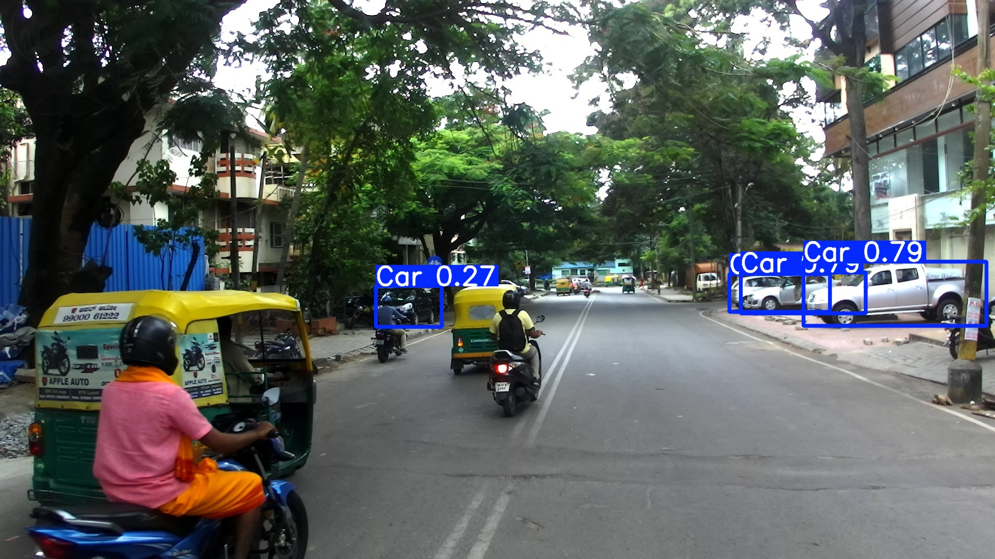
5. Results and Analysis : Performance on KITTI Dataset
Qualitative Results & conclusion
Cross-domain testing clearly reveals the model’s inability to generalize across regions.
Features learned on the KITTI dataset fail in the diverse and complex Indian driving environment.
Sharp declines in mAP, precision, and recall highlight the domain gap.
Classes well-detected in KITTI become nearly unrecognizable in IDD, with AP values near zero.
Future solutions should explore domain adaptation, semi-supervised learning, or training on geographically diverse datasets to improve real-world ADAS performance.
Figure 29,30 . Object detection dataset image.
(Kumar et al., 2018) With testing results
Pg 40 Scientific Seminar

Slide 42
Future Scope of Research
1. Region-Specific Training or Mixed Datasets
2 . Fine-Grained Class Recognition
Incorporate new classes like autorickshaws, street vendors, or animals using incremental learning, few-shot, or zero-shot learning
3. Cross-Modal Sensor Fusion
Combine 2D images with 3D sensors (e.g., LiDAR) to reduce visual ambiguities and enhance domain robustness.
4. Continual & Online Learning
Deploy lightweight adaptive models that update continuously on new unseen environments, maintaining performance in real time
5. Transferability to Other Countries
Extend experiments to more cross-country pairs (e.g., USA→India, China→Europe) to build global ADAS systems.
Pg 42 Scientific Seminar

Slide 43
References & Image credits
Arnold, J. (2016). [Auto racing away in Connaught Place, Delhi, India] [Photograph]. Alamy. https://www.alamy.com/auto-racing-away-in-connaught-place-delhi-india-image230070324.html
Geiger, A., Lenz, P., & Urtasun, R. (2011). KITTI Vision Benchmark Suite [Dataset]. Karlsruhe Institute of Technology; Toyota Technological Institute at Chicago. https://www.cvlibs.net/datasets/kitti/
Kumar, V., Subramanian, A., Mohan, M., Balaji, N., Kumar, S., R. K. R. R., Guruprasad, J., & Rajagopalan, A. N. (2018). IDD: Indian Driving Dataset [Dataset]. International Institute of Information Technology, Hyderabad. https://idd.insaan.iiit.ac.in/dataset/details/
Pg 43 Scientific Seminar

